Slide 2
Agile Post-Award Management
Responding to change over following a plan
Breakout Session #: G06
Presented by: Michelle McNellis, Greg Walker, Rebecca Refoy-Sidibe
Date: 7/26
Time: 9:45
‹#›

Slide 3


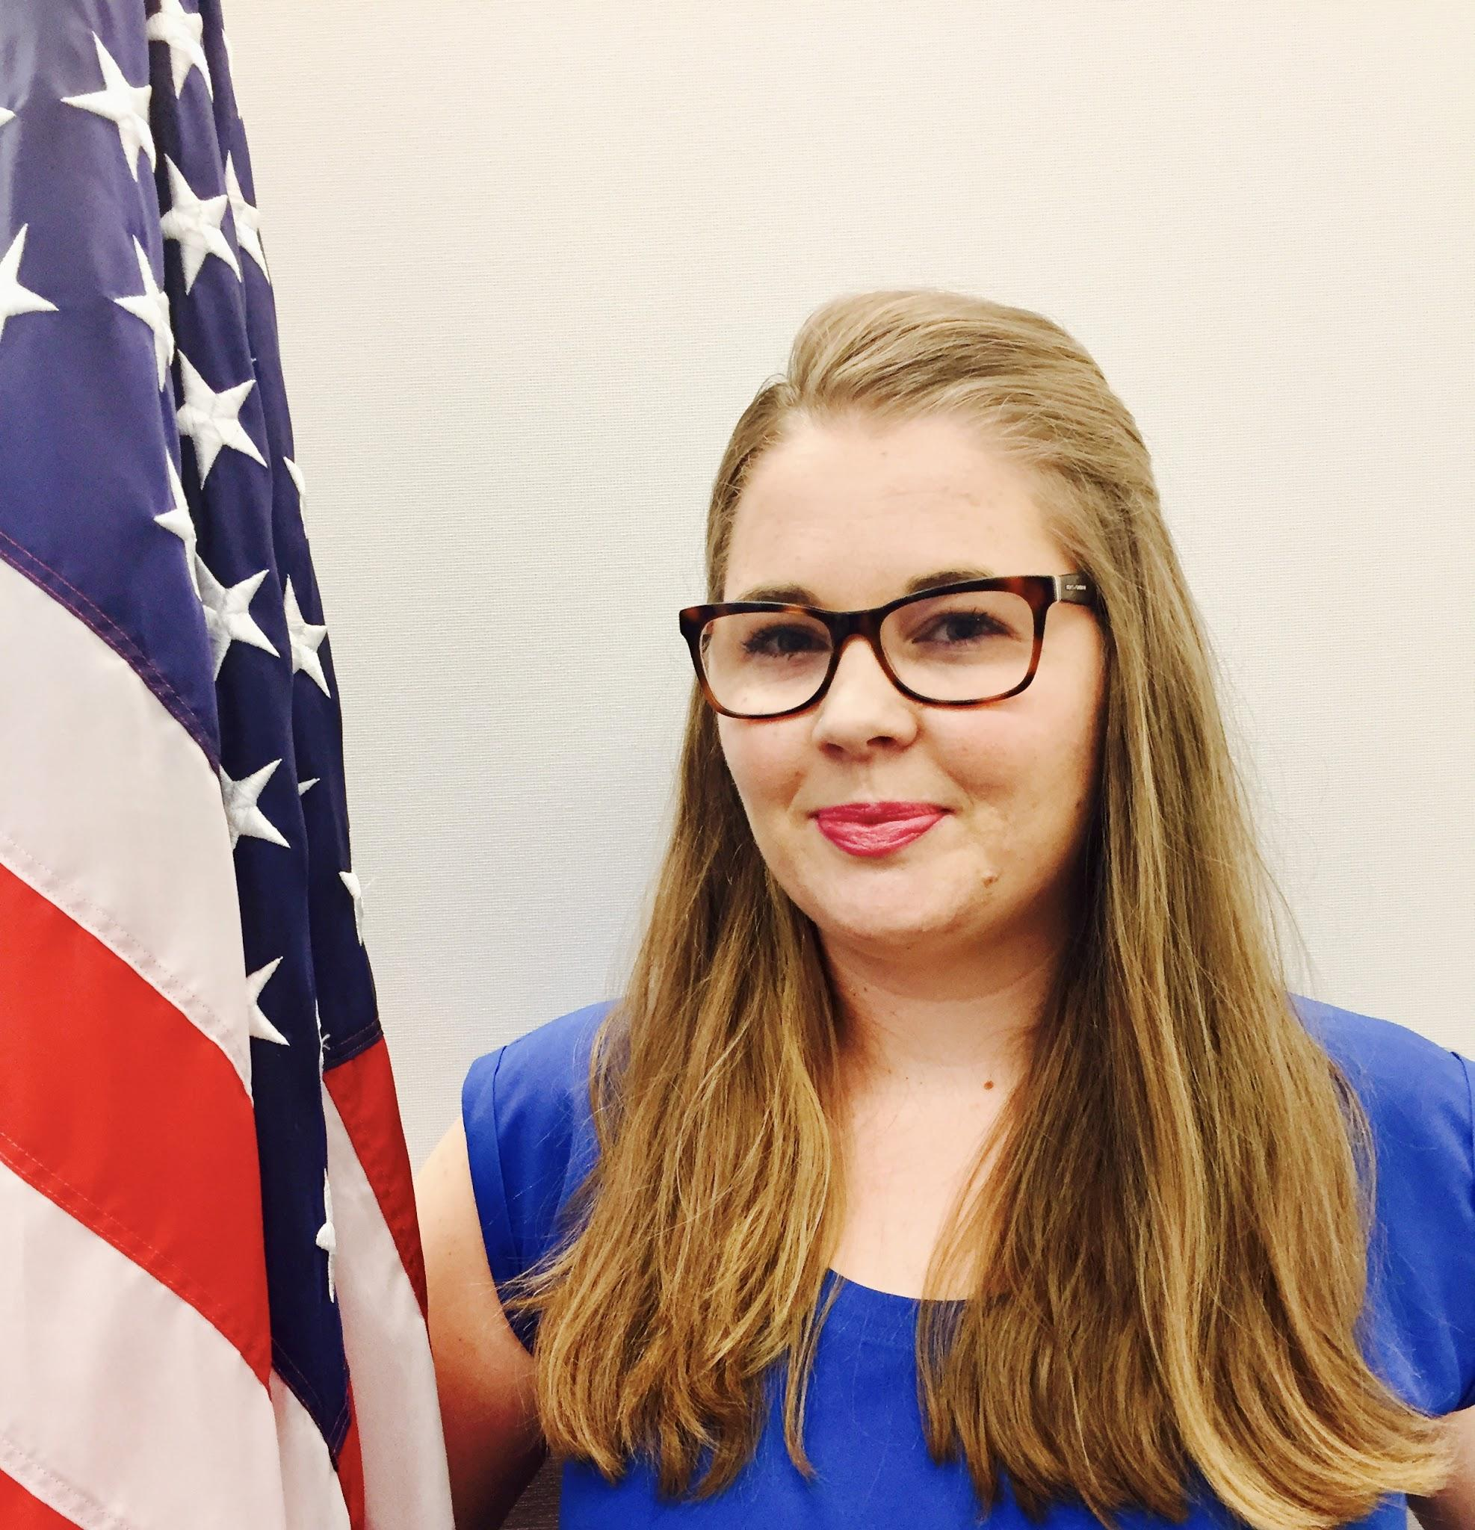
Who we are
Michelle McNellis
Email
Greg Walker
Email
Rebecca Refoy-Sidibe
Email
Bios
‹#›

Slide 4
Modular Contracting
Agile
Build in 2-6 months
User-centered design
Open Source and Reusable
High Performing Teams
Notes:
Assumes things change (agile practices)
- Constant feedback on product being developed (agile practices)
Build in 2-6 months - Delivery is the Strategy:
If only have 60 days, have to dedicate time energy to viable product
Shorter Procurement Times (show vs. tell)
Forces vendors and buyers to focus on building discrete things (best in class vs. passing through prime to get to sub)
Scoped to what user needs are (user centered design)
= Build in space to involve users in the process
SW developed in a way that it is usable by other vendors, government teams, and partner industries (open source)
SW developed by smaller, more efficient teams
Anyone who will be working on this project in the future has a stake in the procurement
If the procurement doesn’t use these principles the end result will be agliefall

Slide 5


Government Contracting: What we’re used to seeing
EVERY requirement on RFP
YEARS to deliver
VENDOR LOCK-IN inevitable
FRUSTRATION on both sides
OUTDATED systems
EXPENSIVE to change
Notes:
Long time to write the RFP and award the contract
Vendors build on proprietary, outdated systems - causing vendor lock in to maintain
Locked in with a single vendor
Black box development environment - know window into what is being build until it is delivered
Change orders ($$$) when inevitable change occurs to the product
Assumes Gov’t and vendor need to know “every requirement” prior to awarding a contract.
System takes years to deliver, but doesn’t meet user needs
Frustration on Bothsides
Susceptible to protests (i.e. delays)
Govt Product owner not happy
Systems are outdated by the time they go into produciton

Slide 6
Resources
Modular contracting
Blog posts about agile
Blog posts about acquisition
Agile BPA
DOL 14(c)
Forest Service

Slide 7
Contact Information
inquiries@18f.gov
Media inquiries: press@gsa.gov
General questions: 18F@gsa.gov
Twitter: @18F
GitHub: 18F
RSS Feed
‹#›

